Slide 1
Project 2 - Action Potential Propagation
Presented by:
Poulami Ghosh
Muthukumar Pandaram
Supervised By:
Dr.Paula Kuokkanen
22-02-2021
MNS Computer Practical Project Presentation- Project 2

Slide 2

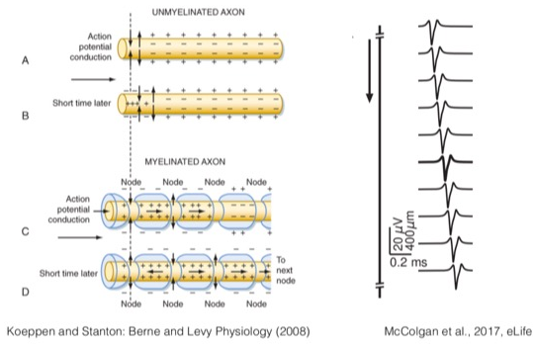
Objective
Understanding the propagation of action potential by study the following
Cable theory
The spatial and time dependency of the axon voltage
Multi-compartment non-myelinated axon model
Relation between axon radius and action potential velocity
Propagation of action potential with I_e at both ends of the axon
Multi-compartment myelinated axon model
22-02-2021
MNS Computer Practical Project Presentation- Project 2

Slide 3
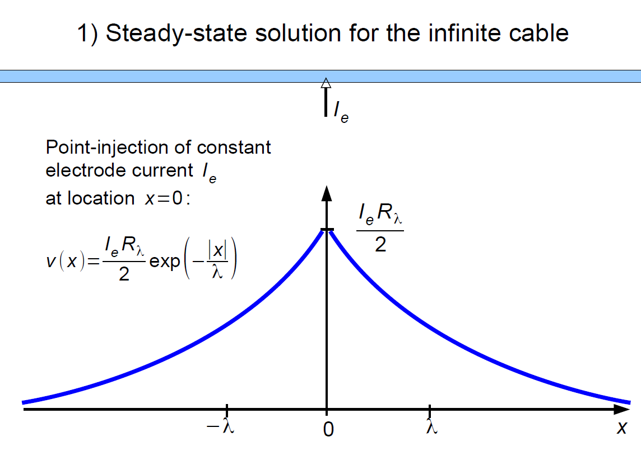
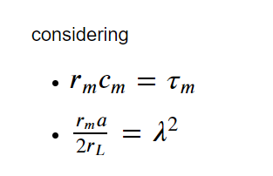


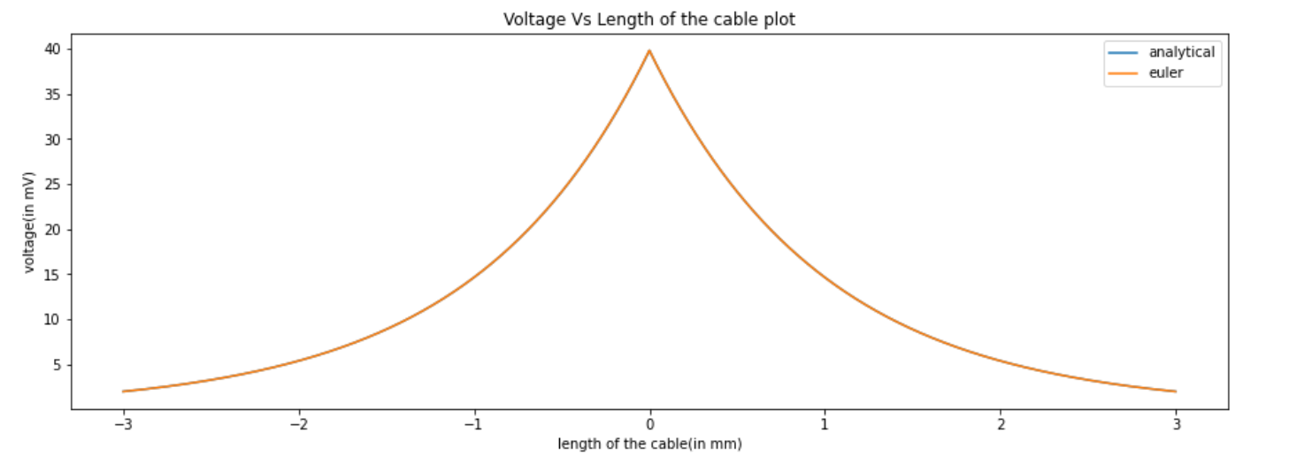


Project Deliverable 1 – Cable equation
2nd Order Derivative Euler
v’’ = 1/λ*(v – r_m*i_m)
v1 = v
v2 = v’
v1’ = v2
V2’ = 1/λ*(v – r_m*i_m)
Boundary conditions:
v(0) =
$\frac{dv}{dx}$ at x=0= -$\frac{1}{λ}\frac{IeRλ}{2}$

Slide 4
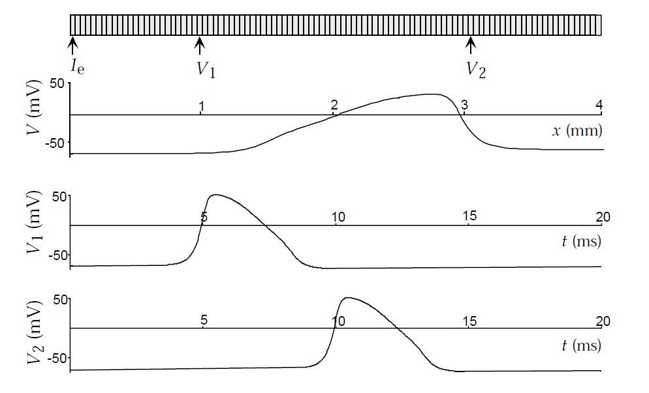
Project Deliverable 2 Multi-compartmental modelling with Crank Nicholson method
Images source:
Dayan and Abbott, Theoretical Neuroscience
22-02-2021
MNS Computer Practical Project Presentation- Project 2

Slide 5
Crank Nicholson Method
Start
Discretise the combined Cable equation and Hodgkin-Huxley membrane current equation using finite difference method.
Solve the Finite difference equations in time
Solve the Finite difference equations in space
Update V in space
If all compartments are updated, else continue iterating
Update V in time
End
22-02-2021
MNS Computer Practical Project Presentation- Project 2

Slide 6
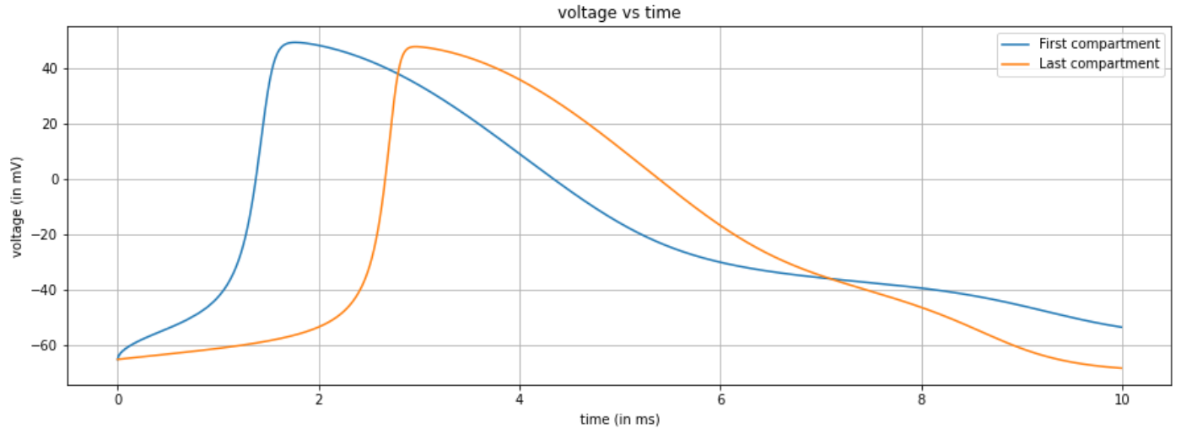
Project Deliverable 3
I_{e}
22-02-2021
MNS Computer Practical Project Presentation- Project 2

Slide 7
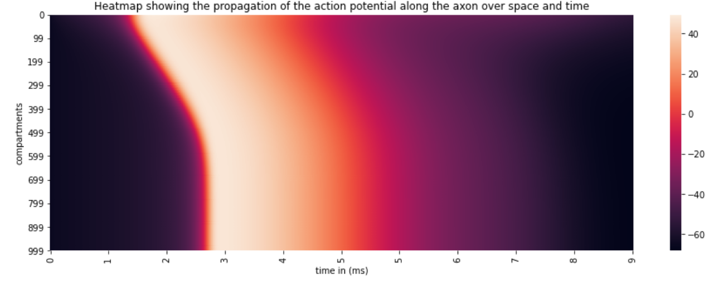
Problem 3 Result:
22-02-2021
MNS Computer Practical Project Presentation- Project 2

Slide 8
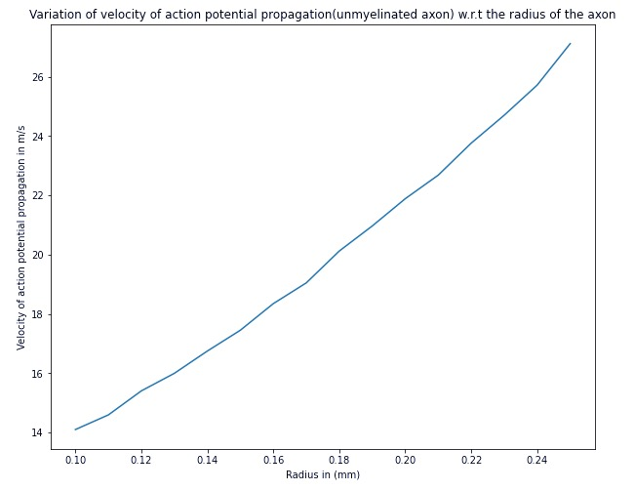
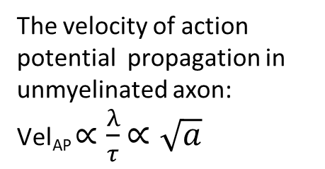
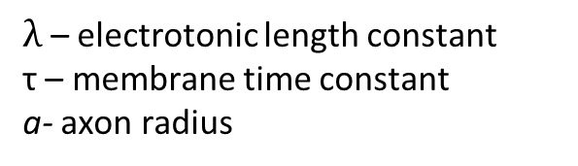
Problem 4
The velocity of action potential propagation in unmyelinated axon:
Vel_{AP} $∝\frac{λ}{τ}$ $∝\sqrt{a}$
$λ$ – electrotonic length constant
τ – membrane time constant
a- axon radius
22-02-2021
MNS Computer Practical Project Presentation- Project 2

Slide 9
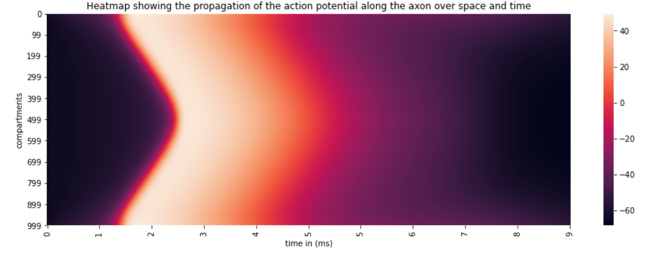
Problem 5
The action potentials generated annihilate each other at the middle of the axon
22-02-2021
MNS Computer Practical Project Presentation- Project 2

Slide 10
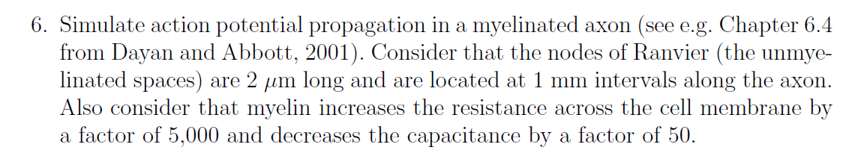
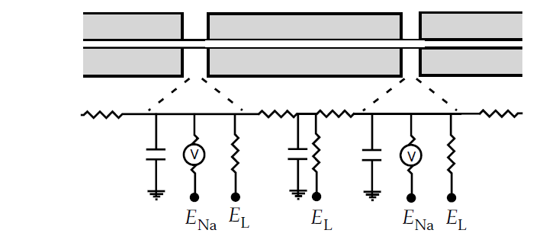
Image source:
Dayan and Abbott, Theoretical Neuroscience
22-02-2021
MNS Computer Practical Project Presentation- Project 2
Notes:
The code used till now can be changed to treat Myelinated part of the axon as a combination of
passive membrane compartments and the Nodes of Ranvier as the active parts of the axon.

Slide 11
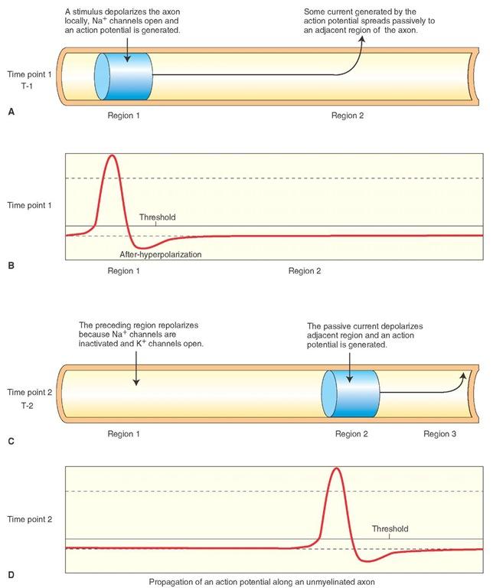
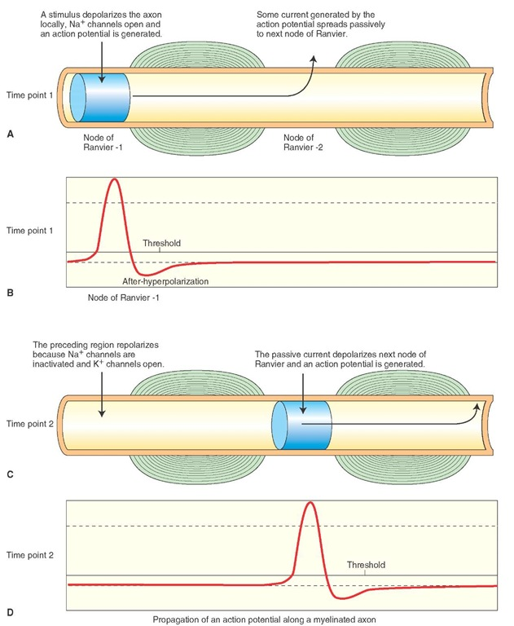
Unmyelinated Axon
Myelinated Axon
22-02-2021
MNS Computer Practical Project Presentation- Project 2
Image src: http://what-when-how.com/neuroscience/electrophysiology-of-neurons-the-neuron-part-3/

Slide 12
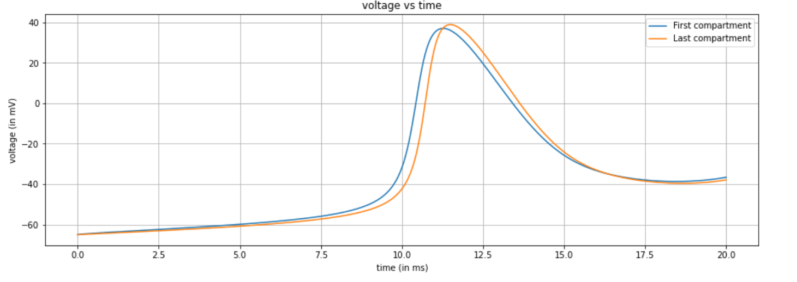
Results:
22-02-2021
MNS Computer Practical Project Presentation- Project 2

Slide 13
Number of Compartments: N
Crank Nicholson
Method
X=0
X=1
X=2
X=N
t=0
-65e-3
-65e-3
-65e-3
-65e-3
t=dt
-62e-3
-65e-3
-65e-3
-65e-3
t=2dt
-60e-3
-62e-3
-65e-3
-65e-3
t=T
-65e-3
-54e-3
22-02-2021
MNS Computer Practical Project Presentation- Project 2

Slide 14
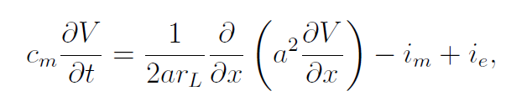
The cable equation
It describes the change of membrane potential across time and space in an axon.
22-02-2021
MNS Computer Practical Project Presentation- Project 2

Slide 15
Hodgkin-Huxley model
The ionic membrane current is given by the Hodgkin Huxley model
22-02-2021
MNS Computer Practical Project Presentation- Project 2

Slide 16
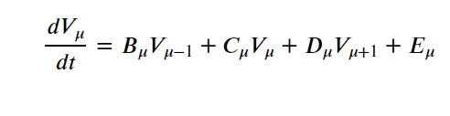
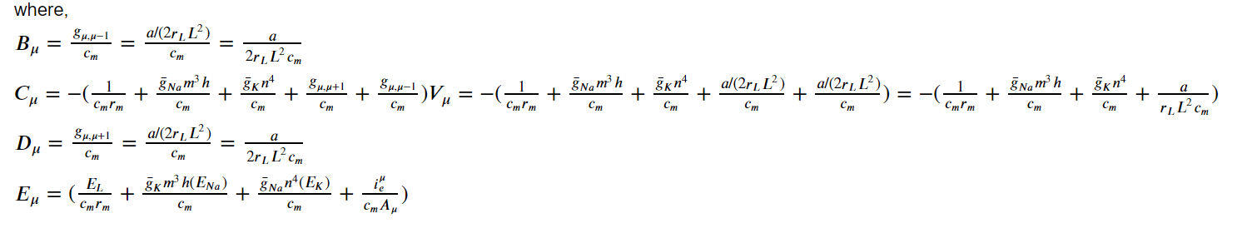
Combining both the cable equation and Hodgkin Huxley model
The membrane potential within compartment μ can be written in the form
22-02-2021
MNS Computer Practical Project Presentation- Project 2

Slide 17

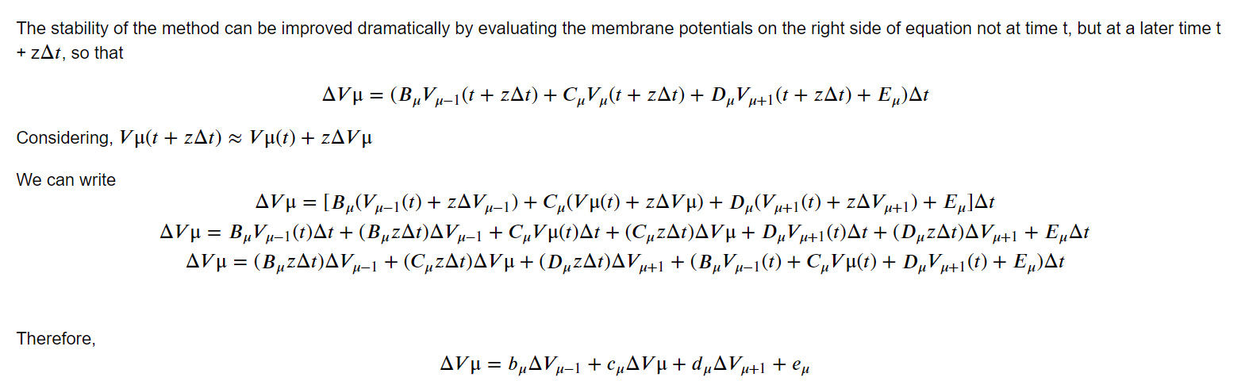
The finite difference form
The finite difference form of the equation in the previous slide can be written as:
22-02-2021
MNS Computer Practical Project Presentation- Project 2

Slide 18
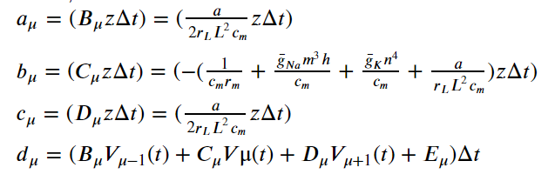
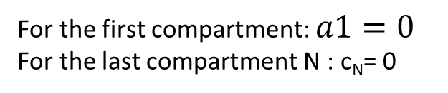
The final coefficients:
For the first compartment: $a1=0$
For the last compartment N : c_{N}= 0
22-02-2021
MNS Computer Practical Project Presentation- Project 2

Slide 19
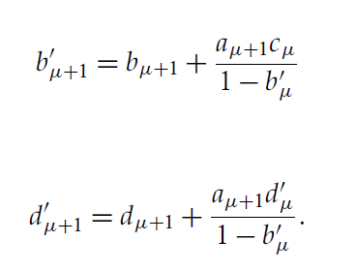

Algorithm to calculate the Voltage in both space and time
$b′1$ and d$′1$ are initialised as b₁ and d₁ respectively
Calculate all the $b′μ$ and d$′μ$ in the following way for all the compartments:
22-02-2021
MNS Computer Practical Project Presentation- Project 2

Slide 20
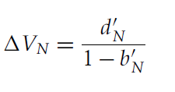
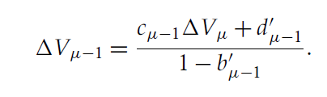

Algorithm continued
The last compartment is treated differently:
The change in membrane potential across space for remaining compartments is updated backwards from the last
compartment using the following expression:
The change in membrane potential across time is updated backwards from the last
compartment using the following expression:
22-02-2021
MNS Computer Practical Project Presentation- Project 2

